Slide 1
ANSI SQL
Sub-queries – session 1

Slide 2
Overview
This session will give an overview of Sub-queries in SQL.
2

Slide 3
Enabling Objectives
At the end of this session, in the next 95 minutes you will be able to:
Define Sub-queries and Demonstrate the use of Sub-queries with the SELECT, INSERT, UPDATE, and DELETE statements by using examples.
3

Slide 4
Sub Queries
Sub Queries with
SELECT
INSERT
UPDATE
DELETE

Slide 5
Scenario
For the complete understanding of ANSI SQL, we are going to make use of Product Management System (PMS) for ABC Traders.
ABC Traders is a company which buys collectable model cars, trains, trucks, buses, and ships directly from manufacturers and sell them to distributors across the globe. In order to manage the stocking, supply, and payment transactions, the above mentioned software is developed.
As per the requirement of the trading company, an inventory system is developed to collect the information of the products, customers, and their payment processing.

Slide 6
Database Tables
There are many entities involved in Product Management System.
We will be dealing with PMS throughout this session.
Offices
To maintain information of offices, for example, office code, address, city, and so on.
Customer
To maintain customer details, for example, customer name, address, and so on.
Employees
To maintain employee
details, for example, ID,
name, and so on.
Products
To maintain information of products, for example, product id, name, and so on.
Payments
To maintain information of payments done, for example, payment date, amount, and so on.
Orders
To maintain Orders done by customers, for example, order no, date, and so on.
Order Details
To maintain Orders done by customers, for example, order no, date, and so on.

Slide 7
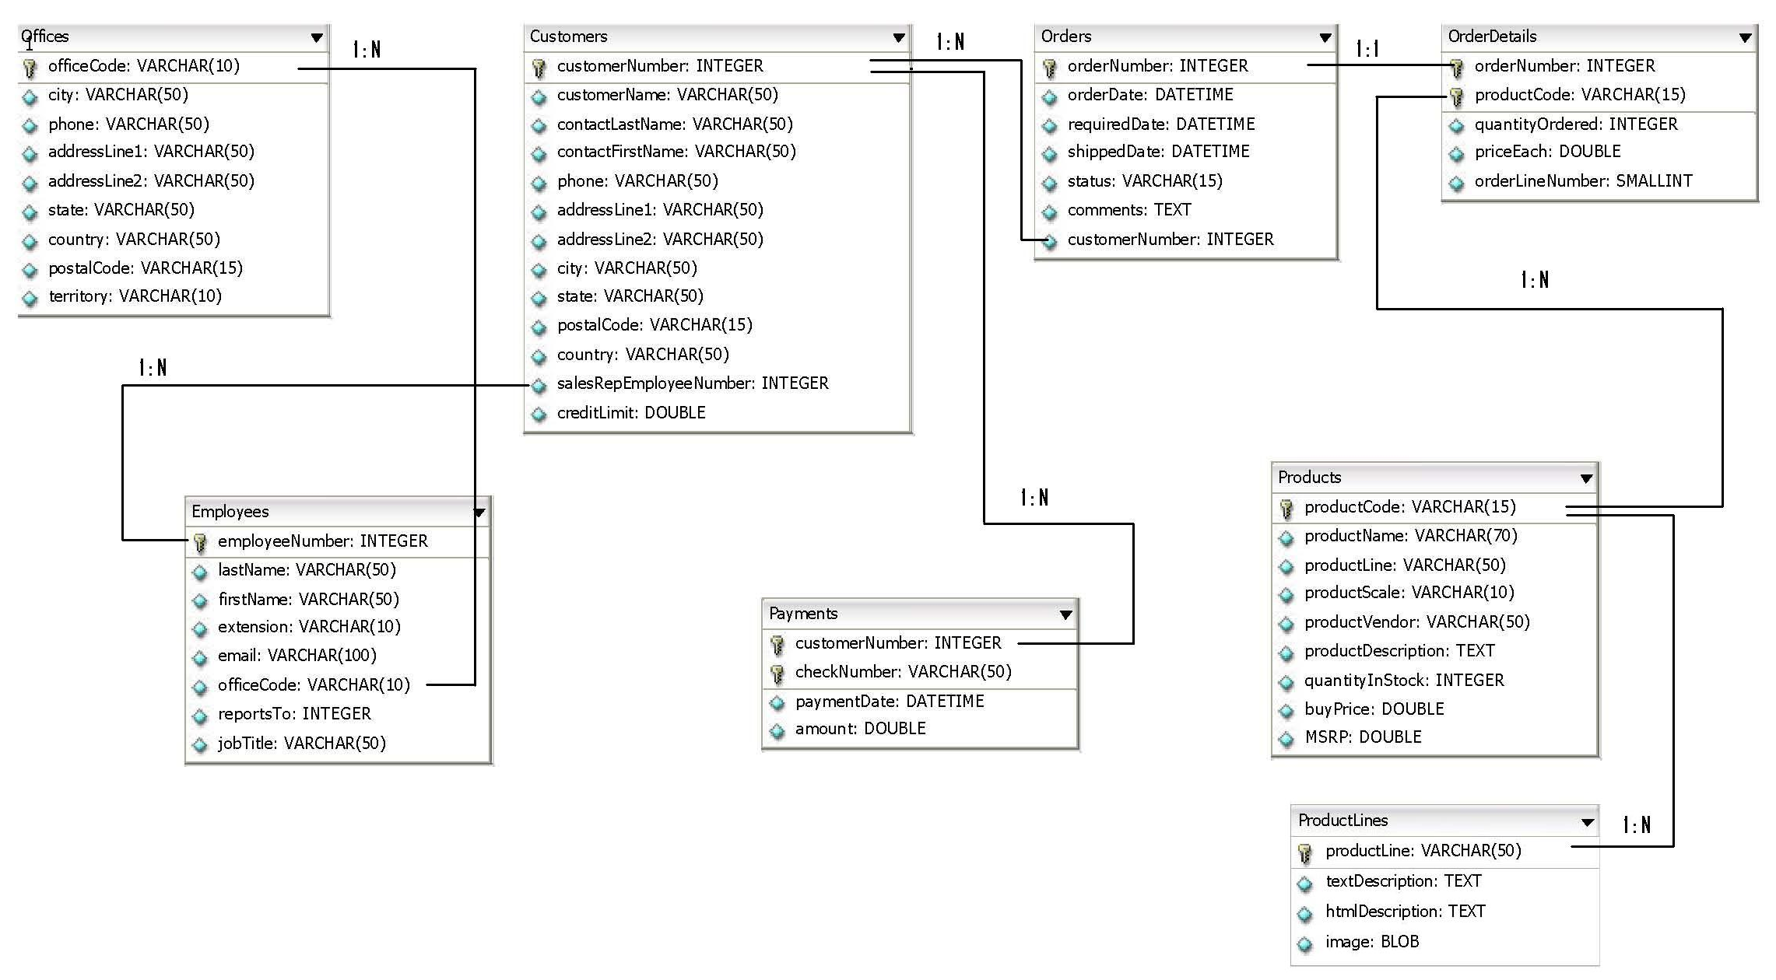
Schema Diagram

Slide 8
Sub Queries

Slide 9
Do You Know?
Have you heard about Nesting of Queries in SQL?
Nested Queries can be applied only to SELECT clause?
Answer: NO

Slide 10
Sub-queries
What is a Sub-query?
Is a query within a query.
It is also called an inner query or a nested query.

Slide 11
Sub-queries
Advantages of Sub-queries:
They allow queries that are structured.
so that it is possible to isolate each part of a statement.
They provide alternative ways to perform operations that would otherwise require complex joins and unions.
Sub-queries are more readable than complex joins or unions.
The innovation of Sub-queries gave the original idea of calling the early SQL “Structured Query Language.”

Slide 12
Sub-query Rules
Sub-queries must be enclosed within parentheses.
A Sub-query can have only one column in the SELECT clause,
unless multiple columns are in the main query for the Sub-query to compare its selected columns.
An ORDER BY cannot be used in a Sub-query, although the main query can use an ORDER BY.

Slide 13
Sub-query Rules
The GROUP BY can be used to perform the same function as the ORDER BY in a Sub-query.
A Sub-query cannot be immediately enclosed in a set function.
BETWEEN operator cannot be used with a Sub-query;
however, BETWEEN can be used within the Sub-query.

Slide 14
Sub-Queries with SELECT

Slide 15
Sub-query: SELECT Statement
Sub-queries are most frequently used with the SELECT statement.
Syntax
SELECT column_name [,column_name]
FROM table1 [,table2]
WHERE column_name OPERATOR
(SELECT column_name [,column_name]
FROM table1 [,table2]
WHERE row_condition );

Slide 16
Sub-query: SELECT Statement
Example
SELECT customers.customername, customers.phone
FROM customers
WHERE customernumber IN (SELECT customernumber FROM payments);

Slide 17
Sub-Queries with INSERT

Slide 18
Sub-query: INSERT Statement
Can also be used with INSERT statements.
The INSERT statement uses the data returned from the Sub-query to insert into another table.
The selected data in the Sub-query can be modified with any of the character, date, or number functions.
Syntax
INSERT INTO table_name [(column1, [,column2])]
SELECT [* | column1 [,column2]
FROM table1 [,table2]
[ WHERE VALUE OPERATOR];

Slide 19
Sub-query: INSERT Statement
Scenario
Create a new table USA_Offices with similar structure as that of Offices.
CREATE TABLE USA_Offices (
officeCode VARCHAR(10) NOT NULL,
city VARCHAR(50) NOT NULL,
phone VARCHAR(50) NOT NULL,
addressLine1 VARCHAR(50) NOT NULL,
addressLine2 VARCHAR(50) NULL,
state VARCHAR(50) NULL,
country VARCHAR(50) NOT NULL,
postalCode VARCHAR(15) NOT NULL,
territory VARCHAR(10) NOT NULL,
PRIMARY KEY (officeCode)
);

Slide 20
Sub-query: INSERT Statement
Copy records having country as USA,
from Offices table into USA_Offices table,
using Subquery with INSERT statement.
INSERT INTO USA_Offices
SELECT * FROM Offices
WHERE country IN (SELECT country FROM offices
WHERE country = 'USA');

Slide 21
Sub-Queries with UPDATE

Slide 22
Subquery – UPDATE Statement
The Subquery can be used in conjunction with the UPDATE statement.
Either single or multiple columns in a table can be updated when using a Subquery with the UPDATE statement.
Syntax
UPDATE table
SET column_name = new_value
[WHERE OPERATOR [VALUE]
(SELECT column_name FROM table_name)
[WHERE row_condition)];

Slide 23
Sub-query: UPDATE Statement
Scenario
We will use the same new table created earlier, USA_Offices and Offices table.
Update values in ‘addressLine2’ column of USA_Offices to ‘Suite 327’
if the ‘city’ value of these records appear in the those records of Office tables where city value is ‘Boston’.
UPDATE USA_Offices
SET addressLine2 = 'Suite 327'
WHERE city IN (SELECT city FROM Offices
WHERE city LIKE '%Boston%');

Slide 24
Sub-Queries with DELETE

Slide 25
Sub-query: DELETE Statement
The Sub-query can be used in conjunction with the DELETE statement
Syntax
DELETE FROM table_name
[WHERE OPERATOR [VALUE]
(SELECT column_name
FROM table_name)
[WHERE) ];

Slide 26
Subquery – DELETE Statement
Scenario:
We will use the same new table created earlier, USA_Offices and Offices table.
Delete records from USA_Offices where the values in ‘city’ column of USA_Offices appear in the values in city column of Offices for ‘NY’ state.
DELETE FROM USA_Offices
WHERE city IN (SELECT city FROM Offices
WHERE state LIKE '%NY%');

Slide 27
Check Your Understanding
What are the advantages of Sub-Queries ?
How to use Sub-queries with the SELECT, INSERT, UPDATE AND DELETE statements?

Slide 28
Recap
The key points covered in this chapter are:
The advantage of a Sub-query is that it allows queries that are structured in order to isolate each part of a statement.
Sub-queries must be enclosed within parentheses.

Slide 29

Source
Website:
http://en.wikipedia.org/wiki/SQL#Subqueries
Disclaimer: Parts of the content of this course is based on the materials available from the Web sites and books listed above. The materials that can be accessed from linked sites are not maintained by Cognizant Academy and we are not responsible for the contents thereof. All trademarks, service marks, and trade names in this course are the marks of the respective owner(s).

Slide 30
You have successfully completed -
ANSI SQL Joins and Their Types – Session 1
30

